Slide 1
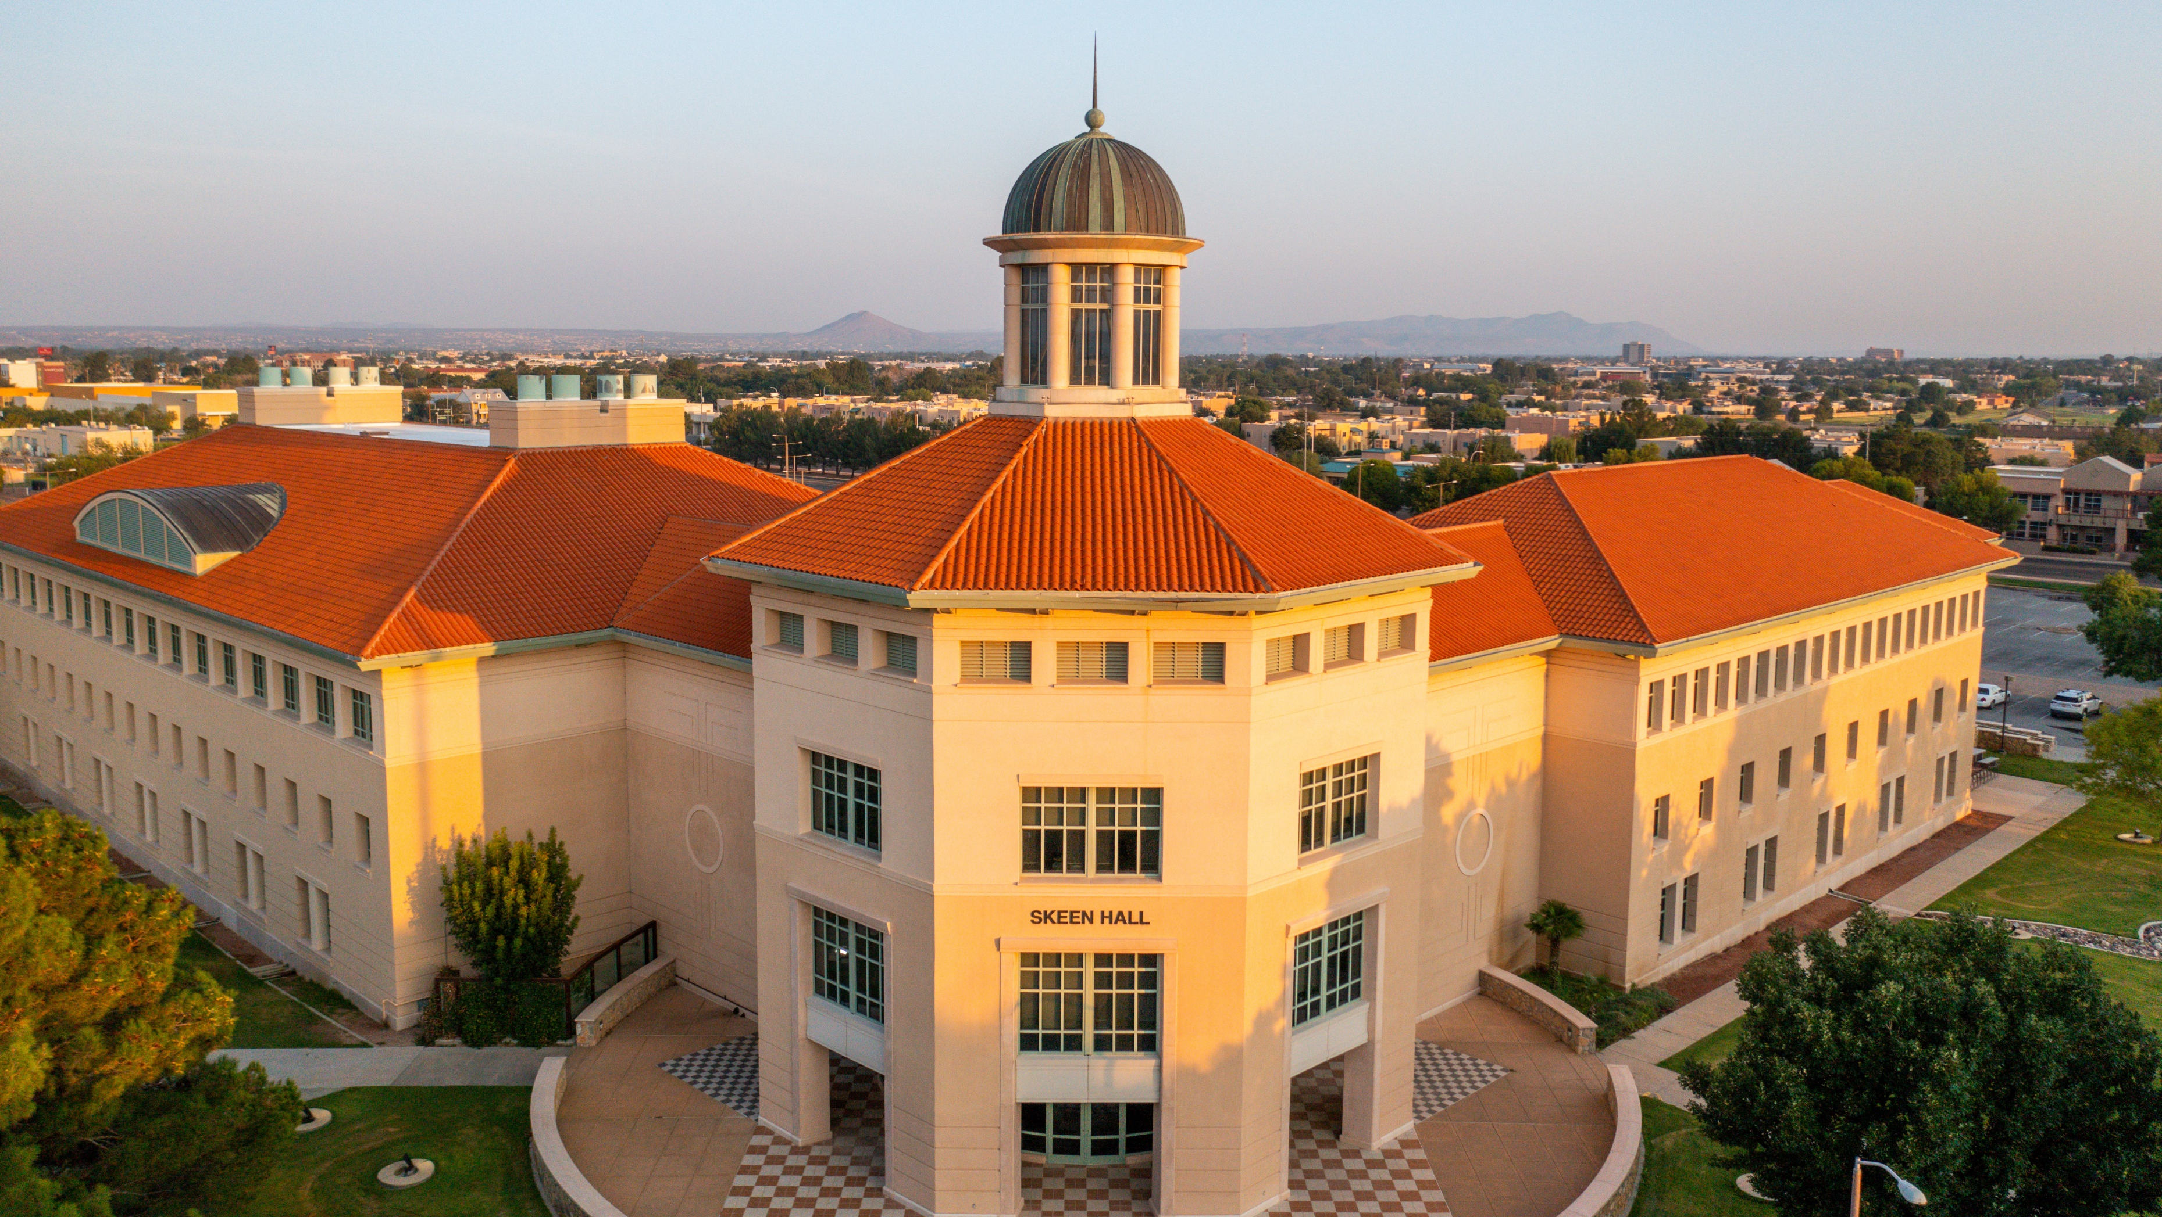
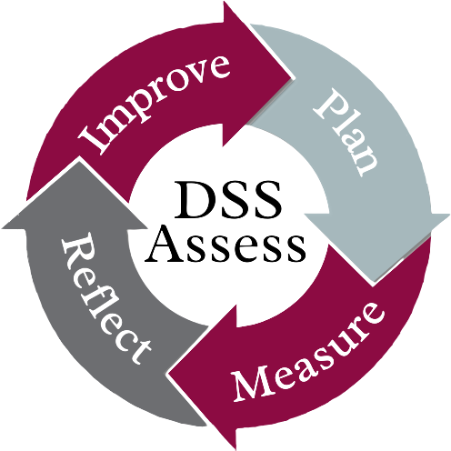
DSS Assess
Dr. Sarah Edwards
Melody Munson-McGee
May 19, 2022

Slide 2
Welcome
Introductions
Community standards
Notes:
Joined in this by Sarah Edwards, Director, Student Involvement and Leadership Programs
Individual introductions: Name, Unit, One thing you want to get from the day
Community standards
Interactive – need feedback
Bathrooms
Cell breaks if needed.
Move to the front – lots of group work. Groups of 3-4
Move around. Different seat, back of the room.

Slide 3
Assessment & Evaluation in Student Success
How should students benefit from participating in our programs and services?
How do we know if we are successful?
Notes:
Recap of comments from April 22 meeting
2014 – began adding uniformity and more intentionality about how we know we are serving students well. And if we believe, that we ARE serving students well, and we have the data to support it, how can we serve students better? How can we continue to improve in how we serve them?
This is the work of assessment. Asking 2 questions on screen.
Many offices in the Division do this and do this well.
One of my roles in DSS is to coordinate how we ask this question and what we do with what we learn.
Change needed to serve our students better. Not necess a reflection on us. The students we had 10 years ago are not the students we have now. We need to tailor our work to suit them.
Mindset list

Slide 4
Our students change: Marist lists
Class of 2023, Fall 2019 incoming
9/11: Shoe check at the airport, TSA screenings, If you see something…
Grew up with smart pens, smart watches, cameras with phones inside. iPods make them nostalgic.
Half their generation are POC; lifetime includes Black president, Sec’y of State (2), BLM
No hangups about sexual orientation: it is just a characteristic
Face recognition, big data, rented textbooks, graphic novels, home defibrillators…
Class of 2025, Fall 2021 incoming
Poetry renaissance
Awareness of veterans
Adapting to virtual
Public health crisis
Redefining arts – culture – commerce
Demanding justice, sustainability in fashion
Decriminalizing drugs
Social changes: death penalty, domestic terrorism, challenges to democracy
Notes:
Marist shift – long, long list (Fall 2019). Pop culture, tech, some world events.
Moved away from list format – which just makes us feel old – to who these students are.
List emphasizes that they are adapting to virtual. Public health crisis, How they take technology and world events (Amanda Gorman) and use it so shape arts, culture, commerce, justice, new appreciation for poetry). Socially awareness just keeps increasing.

Slide 5
Purpose: Assessment & Evaluations
Continuous Improvement
Accountability
To students for effectiveness
To ourselves that we are fulfilling our commitment to students with integrity and sincere commitment to their education
To administration for investment; from state, from NMSU
To other stakeholders: alumni, legislators, community, families
Leadership Development
Notes:
We can’t rest on past practices.
Standing still means falling behind. Constant focus on our effectiveness in delivery of programs and services.
Accountable –
Leadership development: leaders are not necessarily supervisors. You can lead from wherever you are by modeling behavior, asking questions, being determined to improve.

Slide 6
Today…
Assessment foundations
Learning outcomes, reflection, resources
Lunch Assessment, Accountability, Accreditation
Tools
Inventory: Curriculum map and what are we already doing?
Reporting, needs, conclude with an assessment

Slide 7
Thank you
“Assessment is any effort to gather, analyze, and interpret evidence which describes institutional, departmental, divisional, or agency effectiveness.” – Upcraft & Schuh, 1996, p. 18)
Differences between Assessment, Evaluation, and Research

Slide 8
Assessment 101
Dr. Sarah Edwards
Director
Student Involvement and Leadership Programs

Slide 9
What is ?

Slide 10
Reflection in Action
What? Describe a significant experience that you had this past academic year. What did you learn? Where did you learn it? How did you learn it?
So What? Why does it matter? To whom or what is it significant?
Now What? How will you apply what you have learned in future contexts? What will you do differently based on what you have learned?

Slide 11
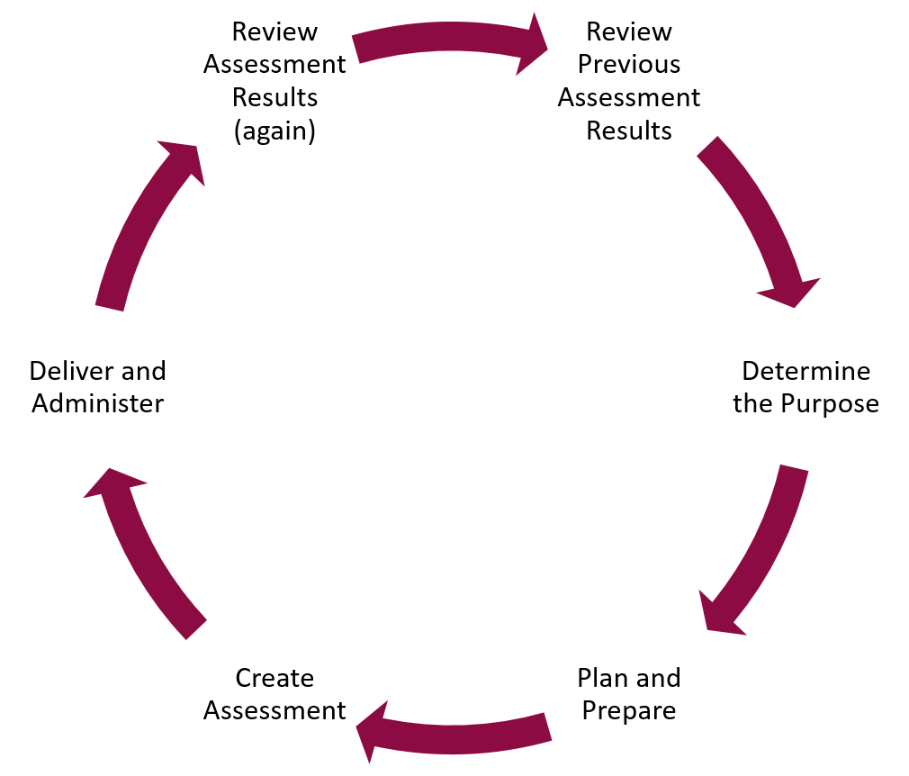
Cycle of Assessment

Slide 12
Why do we do ?

Slide 13
“The question is not what did you offer?, but how are students different as a result of engaging in it?”
– Schuh et. al., 2016, p. 78)

Slide 14
Determine the Purpose and Maintain Focus
What is the goal for the department or office? What is the goal for the program? Why are you having the training/workshop/event?
What do you want the audience to know, be able to do, or feel at the conclusion of the program?
What do you know from previous training programs based on the assessment results?
If the assessment was done well, you should be able to know how effective the program was and what worked well or didn’t work so well.
It can be helpful to look at assessment results for 2 years to see if changes were made and how that impacted the results.
In answering these questions, you will be establishing your learning outcomes for your program and ensuring that your tasks align with the mission and purpose of your area!

Slide 15
Learning outcomes are what participants are expected to demonstrate in terms of knowledge, skills, and attitudes upon completion of a program, course, or activity.

Slide 16
Writing Learning Outcomes
Defined: An identified action that a student is expected to demonstrate in terms of knowledge, skills, and/or attitudes upon completion of a program.
May encompass cognitive skills, performance skills, and affective skills.
Formula:
<Someone> will be able to <action verb> <something> following <experience>.

Slide 17
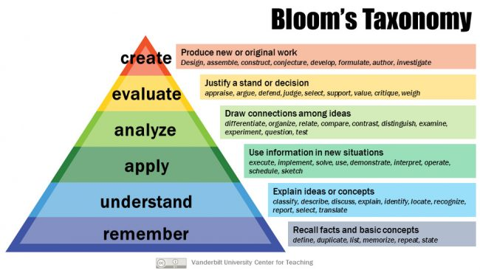
Action Verbs

Slide 18
Learning Outcomes Should:
Be measureable and/or observable (within your control)
Be meaningful (focus on important concepts)
Be manageable (you don’t have to measure everything all the time)
Focus on the end result
Be discrete statements
One concept/outcome per statement
Avoid using “and”

Slide 19
The ABC’s of Learning Outcomes
Audience – Who is doing it?
Behavior – What are they doing?
Condition – When will they do it?
Degree – How will you know they did it?
<Someone> will be able to <action verb> <something> following <experience>.

Slide 20
Example of a Learning Outcome
By participating in the leadership workshop, students will demonstrate three of the five leadership criteria as stated in Kouzes and Posner’s The Leadership Challenge.
Condition
Behavior (in future tense)
Audience
Degree

Slide 21
Not All Learning Outcomes Are Created Equal
Compare these two:
Student employees will be exposed to the principles of risk management.
At the completion of orientation week, Indoor Climbing Facility Staff will be able to verbally articulate the three layers of risk management without error.

Slide 22
Learning Outcomes Activity
Learning Outcomes v. Program Outcomes: A part of the journey to achieving goals is developing learning outcomes and program outcomes.
Learning Outcomes are what you hope the participants attending your program gain from their experience.
Program Outcomes are the end result you hope your program achieves or accomplishes.
Activity: As a group develop at least 3 learning outcomes and program outcomes for the scenario given on the sheet.

Slide 23
How do we do ?

Slide 24
Creating Assessments
Planning your assessment needs to happen before the program – not as an after-thought.
Assessing your program informs you if the learning outcomes were met and if the audience learned what you wanted them to learn.
How we ask our questions makes a HUGE difference!
There are several factors to consider in deciding the type of assessment to conduct:
Survey types – pre- and post-tests, satisfaction, and experience outcomes
Electronic vs. paper – typically you’ll want to use the one that will give you the highest return rate
Observation – great way to learn about satisfaction or logistics…plan time to debrief as a staff afterwards!

Slide 25
Types of Assessment
Participation Surveys
Rubrics
Learning Contracts
Photography and reflection
Observations with documentation
Reflective conversations
Reflective writing (“1 minute paper”)
Participant Interviews
Exit Interviews

Slide 26
Challenges with Assessment
You have to find the right tool for your group/event
Work within the realm you are comfortable, don’t be afraid to try new tools

Slide 27
Overcoming Obstacles – Discuss at your Table
Answer these questions:
What are the potential challenges with assessment?
What are some intentional ways to overcome these challenges?
Give three suggestions/examples of building assessment and/or reflective questions into your work over the course of a year.
Report out to the group at large

Slide 28
Overcoming Barriers to Assessment
Work with a core group of people committed to assessment
Focus on the contributing to the institutional direction
Do what you can when you can
Just Do It!

Slide 29
After the

Slide 31
Review Assessment Results
Get an initial sense of the results by glancing at them
Run analysis and look at what they are telling you
Look at the strengths and areas for improvement
Look at the results and how can you use that feedback immediately with future programs and events (even on different topics)
Look at if your learning outcomes were met…if not, you may need to revisit the topics with the audience
What did you personally learn through this process?

Slide 32
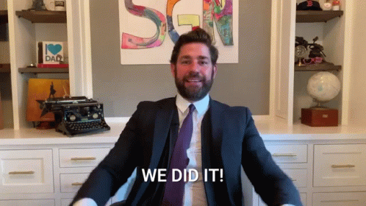
Success is not measured by what one brings, but rather by what one leaves. - Unknown
Time for a break ☺

Slide 33
Assessment, Accountability, Accreditation
Shelly Stovall
Associate Provost, Program Development & Accreditation

Slide 34
Inventory: Where are we now, OR how do we start?
Notes:
Foundations this morning: What is assessment?
Old hat for some. New hat for others.
What do we measure now?
What can we start to measure?
If you need to get to a new place, start with a map.
B/c we are not doing assessment for the sake of assessment.
B/c NMSU is all about student success and social mobility.
B/c DSS is all about empower, engage, and guide students.
B/c each person here works in a unit that does this in their own way.

Slide 35
Inventory
Notes:
We have a map – not final, but what we are starting with.
Skills from AAC&U, Gen ed model. 2019 implemented in the state.
Allows alignment with academics. Also align with NMSU LEADS 2025; unit mission and goals.
I want your feedback on this today. This is one of your 3 options for a report out in about 30 minutes.

Slide 36
Inventory

Slide 37
Inventory
How do we meet goals?
Feedback on curriculum map
What are you measuring now?
What can you start to measure?
Groups of 3–4 people
Make notes on post-its for each question (1–3)
Report out and posting the post-its
Timing

Slide 38
Reporting
Crimson Connection
Reporting feedback, Groups of 3–4 people
Make notes on post-its for planning and results report
Cycle: July 1 to June 30
Due dates
Report out and posting the post-its

Slide 39
Needs Assessment: Where and how?
Five-year plan
Year 1, July 2022–June 2023, Piloting Assessment
Years 2–4, July 2023–June 2026, Building a Culture
Year 5, July 2026–2027, Assessing our Practices

Slide 40
Needs Assessment: Where and how?
Year 1, July 2022–June 2023, Piloting Assessment
Identify teams, develop staff ability in assessing learning, programs, services, and operations through year-long guided practice.
Pilot assessment process and materials and revise as needed for year 2.
100% of teams complete an assessment cycle, from planning to closing the loop.
Document guided practice for use in onboarding as new people join the assessment effort.
Led by the DSS Leadership, units draft assessment plans for their areas.

Slide 41
Needs Assessment: Where and how?
Years 2–4, July 2023–June 2026, Building a Culture
Solidify a culture of assessment in DSS as demonstrated by
Annual assessment planning and reporting with 100% participation from all areas of the Division of Student Success.
Annual celebration of co-curricular assessment (DSS Assess) with annually increasing participation.
Expanding co-curricular assessment by welcoming participation from NMSU’s co-curricular learning spaces outside DSS.

Slide 42
Needs Assessment: Where and how?
Year 5, July 2026–2027, Assessing our Practices
In addition to completing assessment for outcomes, programs, services, and operations, review and assess the previous four years regarding our stated outcomes of continuous improvement of programs and services; accountability to shareholders; and leadership development.
Revise assessment processes as needed for implementation in year 5 and year 6.
Notes:
Discussion

Slide 43
Needs Assessment: Meeting time?
Notes:
Unlikely to find a single suitable time. Must find a time in which ever area has representation.

Slide 44
Assessment
Please reflect on the following:
Was this day a good use of your time, and why?
What do you need as you prepare to develop an assessment plan for your area?
What makes you excited about assessment? What is your biggest concern?
Please give us any other comments.

Slide 45
Assessment: Discussion
Was this day a good use of your time, and why?
What do you need as you prepare to develop an assessment plan for your area?
What makes you excited about assessment? What is your biggest concern?
Please add any other comments.

Slide 46
Thank you
Any questions?

